Slide 1

PowerPoint Slides
Computer Organisation and Architecture
Smruti Ranjan Sarangi, IIT Delhi
Chapter 12
I/O and Storage Devices
PROPRIETARY MATERIAL. © 2014 The McGraw-Hill Companies, Inc. All rights reserved. No part of this PowerPoint slide may be displayed, reproduced or distributed in any form or by any means, without the prior written permission of the publisher, or used beyond the limited distribution to teachers and educators permitted by McGraw-Hill for their individual course preparation. PowerPoint Slides are being provided only to authorized professors and instructors for use in preparing for classes using the affiliated textbook. No other use or distribution of this PowerPoint slide is permitted. The PowerPoint slide may not be sold and may not be distributed or be used by any student or any other third party. No part of the slide may be reproduced, displayed or distributed in any form or by any means, electronic or otherwise, without the prior written permission of McGraw Hill Education (India) Private Limited.
PROPRIETARY MATERIAL. © 2014 The McGraw-Hill Companies, Inc. All rights reserved. No part of this PowerPoint slide may be displayed, reproduced or distributed in any form or by any means, without the prior written permission of the publisher, or used beyond the limited distribution to teachers and educators permitted by McGraw-Hill for their individual course preparation. PowerPoint Slides are being provided only to authorized professors and instructors for use in preparing for classes using the affiliated textbook. No other use or distribution of this PowerPoint slide is permitted. The PowerPoint slide may not be sold and may not be distributed or be used by any student or any other third party. No part of the slide may be reproduced, displayed or distributed in any form or by any means, electronic or otherwise, without the prior written permission of McGraw Hill Education (India) Private Limited.
1

Slide 2
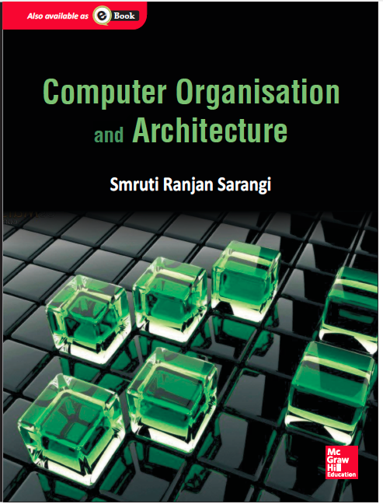
These slides are meant to be used along with the book: Computer Organisation and Architecture, Smruti Ranjan Sarangi, McGrawHill 2015
Visit: http://www.cse.iitd.ernet.in/~srsarangi/archbooksoft.html

Slide 3

Outline
Overview
Physical Layer
Data Link Layer
Network Layer
Protocol Layer
Case Studies
Storage Media

Slide 4
I/O Devices
Memory
Hard disk
Computer
Keyboard
Monitor
Mouse
Printer

Slide 5
I/O Devices
I/O Devices
Hard disk
Network card
Printer, scanner, camera, speakers
They are connected to the motherboard with I/O ports
A set of metallic pins for attaching with external connectors
Example : USB port, DVI Port.

Slide 6
Software's View of I/O Devices
Linux defines two system calls
read (int file_descriptor, void *buffer, int num_bytes)
write (int file_descriptor, void *buffer, int num_bytes)
All devices are perceived to be files in the /dev file system
We can read bytes from them, or write bytes to them
Two kinds of devices : character (keyboard, mouse), and block (hard disk, network card)

Slide 7
Operating System's I/O Stack
Application
Request
Response
Operating
Kernel
Device
system
driver
Software
Hardware
I/O
I/O
Processor
device
system
A request goes through the kernel, device driver, processor, and I/O system
I/O devices are connected to the motherboard via add-on cards, or directly

Slide 8
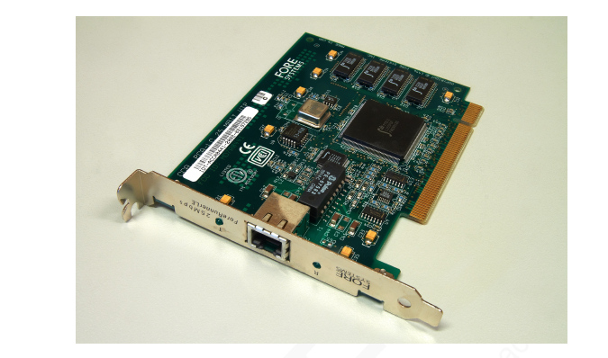
A Network Card

Slide 9
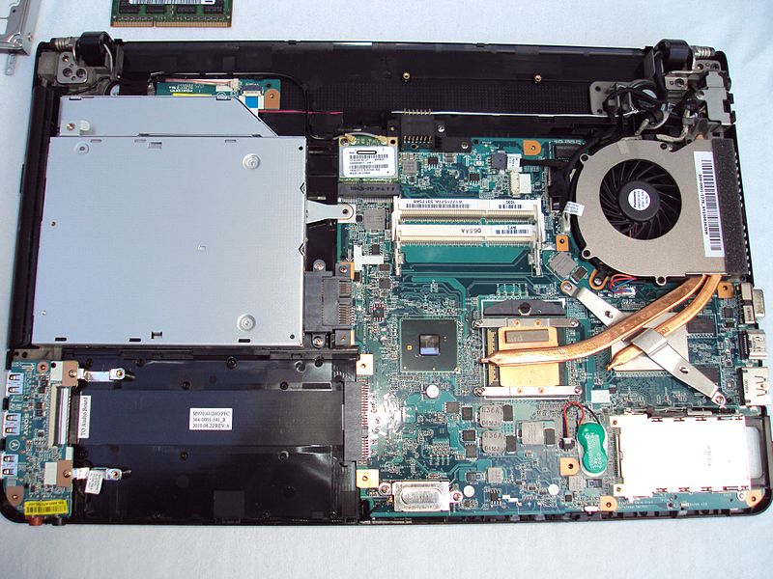
Chipset and Motherboard
A motherboard is a printed circuit board connecting the processors and auxiliary chips
The additional chips comprise the chipset

Slide 10
Architecture of the Motherboard
Processor
Frontside
bus
PCI express
Memory
Graphics
bus
North Bridge
modules
processor
chip
PCI express
SATA
Network
bus
South Bridge
bus
card
chip
Hard
disk
PCI express
Intel high
bus
def. audio on
a PCI bus
USB
USB
USB
USB
Audio/ Mic
USB ports
ports

Slide 11
I/O Buses
The different components on the motherboard are connected with I/O buses
I/O buses are also used to connect external devices to the motherboard
An I/O bus is a set of wires that carries data and control signals between a set of devices. These devices use the bus to transmit data and control signals between each other.

Slide 12
Layers in the I/O System
Protocol layer
Network layer
Data link layer
Transmission
Synchronisation
Physical layer

Slide 13
Layers in the I/O System
Physical Layer
Transmission Sublayer → Defines the electrical specifications of the bus, and the methods for encoding data
Synchronisation Sublayer → The timing of signals
Data link layer
Framing, buffering, error correction, transactions

Slide 14
Layers - II
Network Layer
I/O device addressing, location, routing
Protocol Layer
End to end request processing
Interrupts, and polling
DMA (Direct Memory Access)

Slide 15
Outline
Overview
Physical Layer
Data Link Layer
Network Layer
Protocol Layer
Case Studies
Storage Media

Slide 16
Active High and Active Low
Clock
0
1
1
1
0
1
0
1
0
0
0
Data
(a) Active high signalling
Clock
0
1
1
1
0
1
0
1
0
0
0
Data
(b) Active low signalling

Slide 17
LVDS Signalling
Low Voltage Differential Signalling
V
cc
3.5mA
A
T2
T1
A
Op amp
line 1
+
100 Ω
R
d
-
A
A
line 2
If (A = 1) there is a voltage difference of 350 mV across the op Amp
Else there is a voltage difference of -350 mV
Smaller is the voltage swing, faster is the circuit

Slide 18
Terminology
Physical Bit
A value of 0 or 1 on the bus
Logical Bit
A function of a sequence of physical bits. Logical bits are passed to the next layer.
Bit Period
Time it takes to transmit a single bit
I/O Clock Period
One clock cycle of the I/O clock

Slide 19
Binary vs Ternary Signalling
Binary Signalling → The physical bit can either take a value of 0 or 1
Ternary Signalling → We have three physical bits : 0, 1, and idle
The idle state of the bus corresponds to the case where no signal is transmitted
LVDS naturally supports ternary signalling. When the voltage difference is less than the threshold, the bus is in the idle state.

Slide 20
Return to Zero (RZ)
Clock
0
1
1
1
0
1
0
1
0
0
0
Data
Logical 0 : 0 → idle
Logical 1 : 1 → idle

Slide 21
Manchester Encoding
Clock
0
1
1
1
0
1
0
1
0
0
0
Data
Logical 1 : 0 → 1
Logical 0 : 1 → 0

Slide 22
Non Return to Zero (NRZ)
Clock
0
1
1
1
0
1
0
1
0
0
0
Data
Logical 0 : physical 0
Logical 1 : physical 1

Slide 23
Non Return to Zero Inverted (NRZI)
Clock
0
1
1
1
0
1
0
1
0
0
0
Data
Logical 0 : no transition
Logical 1 : transition

Slide 24
Synchronisation Sublayer
How does the receiver know, when to read the data ?
It might not have the same clock as the sender
The signal might have a variable amount of delay
The receiver might sample the clock in the keepout region
The signal cannot be sampled in a certain interval of time around the clock edge (recall setup time, and hold time)

Slide 25
Synchronous Buses
I/O link
D
Q
Sender and receiver have the same clock
The signal arrives at the receiver before its clock enters the keepout region
Figure shows the receiver circuit

Slide 26
Mesochronous Buses
I/O Link
D
Q
Tunable delay
element
Fixed (known) propagation delay
Use a delay element to keep transitions out of the keepout region

Slide 27
Source Synchronous Bus
I/O link
D
Q
xclk
rclk
Tunable delay
Delay calculator
element
D
Q
to receiver
rclk
Sender sends clock along with the signal
Clock data in with the sender's clock (xclk)
Transfer the data to the receiver's clock domain using a tunable delay element

Slide 28
Asynchronous Bus
I/O Link
D
Q
Clock recovery
circuit
Tunable delay
Delay calculator
element
rclk
to receiver
D
Q
rclk
No guarantee of timing
Recover the clock from the transitions in the data
Transfer to the receiver's clock domain using a delay element

Slide 29
Communication with Strobe Signals
Data
Strobe
The strobe signal indicates the availability of data.
The sender has no way of knowing that the receiver has read the data

Slide 30
4 Phase Handshake
Data
Strobe
Ack
Receiver asserts the ack signal after it has read data.
The sender deasserts the strobe, and stops sending data
The receiver resets the ack signal

Slide 31
2 Phase Handshake
Data
Strobe
Ack
Instead of asserting, and deasserting signals, we toggle their values
No need to pause between transmtting bits.
The sender starts sending the next bit after it sees the ack line to be toggled

Slide 32
Outline
Overview
Physical Layer
Data Link Layer
Network Layer
Protocol Layer
Case Studies
Storage Media

Slide 33
Framing
Create a frame of data from logical bits
A frame is an atomic unit of data (data packet)
How do we detect frames ?
Demarcation by inserting pauses → wastes bandwidth
Bit count → Count the number of bits. What if we miss a bit ?

Slide 34
Frame Detection
Bit/Byte Stuffing → Insert special symbols at the beginning and end of frames.
For example, insert the sequence : 0xDEADBEEE, at the beginning. If DEADBEEE occurs inside the message, repeat the symbol two times. (Similar to ‘\’ in C++/ Java)

Slide 35
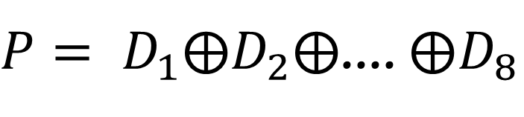
Error Detection/ Correction
Single error detection. Have a parity bit.
$P= D_{1}⨁D_{2}⨁$.... $⨁D_{8}$
Data bits
Parity bit

Slide 36
Other Error Detection/Correction Schemes
Single Bit Error Correction → Achieved by having multiple parity bits (taught in classes on data communication, and coding theory)
SECDED (Single Error Correct, Double Error Detect) →Taught in courses on coding theory
CRC (Cyclic redundancy check) → Used to check a burst of errors.

Slide 37
Arbitration
In a multidrop bus, multiple transmitters are connected to a single bus
How do they get access to the bus ? Use a method called arbitration
Two methods for arbitration → centralised, and daisy chain

Slide 38
Centralised Arbitration
Device 4
G
r
a
Release
Request
n
t
Request
Request
Device 1
Grant
Arbiter
Grant
Device 3
Release
Release
R
R
e
G
e
l
r
q
e
a
u
a
n
e
s
t
s
e
t
Device 2
request → grant → release

Slide 39
Daisy Chain Arbitration
Bus grant
Bus release
Arbiter
Device 1
Device 2
Device n
Device interested to transmit asserts bus grant
The arbiter injects a token.
The token passes from device to device.
The last device sets the release signal, and destroys the token.

Slide 40
Transaction Oriented Bus
A request from the sender to the receiver has a given semantics. It consists of an atomic sequence of messages.
This is called a transaction.
Bus that allows both sides to communicate at the same time → full duplex
Only one side at a time → half duplex

Slide 41
DRAM Read Transaction
clock
RAS
CAS
Address
row
col
row
col
Command
read
read
Data ready
Data

Slide 42
Split Transaction Buses
A transaction unnecessarily ties up the bus
A transaction might also have long pauses in the middle.
Use a split transaction bus. Typically consists of a request sub-transaction, and response sub-transaction.
Other messages can be sent between request and response.
Flexible, increases bandwidth, simpler

Slide 43
Outline
Overview
Physical Layer
Data Link Layer
Network Layer
Protocol Layer
Case Studies
Storage Media

Slide 44
I/O Port Addressing
Every device on the motherboard exposes a set of I/O ports.
An I/O port in this case, is a software entity.
Each software I/O port is a wrapper on the actual hardware I/O port
Software interface
Registers
Input
Output
Port controller
Port connector

Slide 45
Software Interface
Each I/O port exposes a set of 8-32 bit registers to software
Software writes to the registers. The port controller automatically sends the information to the I/O device.
Similarly, to read data the processor reads the registers of the port controller.
Example : Intel processors define 64K, 8 bit I/O ports. Each port has a 16 bit port number.

Slide 46
I/O Address Space
Set of all I/O ports that are accessible to software
x86 processors have two instructions to access I/O ports → in and out
Instruction
Semantics
In r1,<io port>
r1 ←
Contents of <i/o port>
Out r1, <io port>
Contents of <i/o port> ←
r1

Slide 47
I/O Mapped I/O
A request contains an I/O port address
The processor sends it to the Northbridge chip.
The Northbridge chip forwards it to the Southbridge chip (if necessary)
The Southbridge chip forwards it to the destination. (there might be several more hops)
Each chip maintains a small routing table.
The response follows the reverse path.

Slide 48
Memory Mapped I/O
Problems with I/O mapped I/O
The programmer needs to be aware of the addresses of the I/O ports.
The same device might have different port addresses across different motherboards
Programs will cease to work.
It is hard to transfer a block of data (need to send it instruction by instruction)
Solution : memory mapped I/O

Slide 49
Memory Mapped I/O
Define a virtual layer between I/O ports, and the application.
The operating system can use the paging mechanism to map I/O ports to memory addresses.
Whenever, we write to a memory address that is mapped to an I/O port, the TLB directs the request to the I/O system.
Similarly, for reading data, the response comes from the I/O System

Slide 50
Advantages
The operating system creates the mapping between the I/O ports and the memory addresses
The same I/O program runs on multiple machines
Reading and writing to I/O devices requires normal load/store instructions
Easy to read and write a large block of data using block load/store operations available in some architectures (e.g, x86)

Slide 51
Outline
Overview
Physical Layer
Data Link Layer
Network Layer
Protocol Layer
Case Studies
Storage Media

Slide 52
Protocol Layer
Defines the interaction between the host (processor) and I/O devices
The protocol layer consists of high level commands that are sent over the three lower layers
Three methods :
(1) Polling, (2) Interrupts, (3) DMA (Direct Memory Access)

Slide 53
Polling
Example :
Assume that the application running on the processor wants to print a page.
It needs to first find if the printer is free before sending it the contents of the page.
It keeps querying the printer for its status. If its status is busy, the program waits for some time, and queries again.
This method is known as polling.
Simple, yet inefficient (traffic, power, computational time)

Slide 54
Interrupts
The host tells the device to notify it if there is a change in its status
In this case, if the printer is busy, then the host lets the printer know that it is interested in printing one more page.
The printer sends it an interrupt, once it is free.
The host processes the interrupt, and the application subsequently sends the print job

Slide 55
DMA (Direct Memory Access)
Now, let us assume that the application is aware that the printer is free.
It needs to transfer several MB of data to the printer for printing.
If it transfers data byte by byte, the processor will be tied up for the entire duration
Even if it uses memory mapped I/O, the entire operation will require a large amount of CPU time.
Best solution : outsourcing

Slide 56
DMA Engine
Assign the work of transferring data between main memory and the I/O devices to the DMA engine
The DMA (direct memory access) unit is typically a part of the Northbridge chip
It has access to main memory, and to I/O devices. It can seamlessly transfer data between them.
Once it is done, it sends an interrupt to the processor.
The processor programs the DMA engine with the addresses in memory, size of data, and I/O address locations

Slide 57
DMA Modes
Burst mode
Locks the FSB and the buses to the I/O device till the entire transaction is over.
Cycle stealing mode
Split-transactions
Transfers data in smaller chunks. DMA traffic typically has a much lower priority than regular traffic.

Slide 58
Outline
Overview
Physical Layer
Data Link Layer
Network Layer
Protocol Layer
Case Studies
Storage Media

Slide 59
PCI Express
Motherboards needs a bus to connect the I/O elements
There were many buses in use in the late nineties. Two of them were very popular.
PCI (Peripheral Component Interconnect)
AGP (Accelerated Graphics Port)
A standardisation effort led to the PCI-Express (PCI-X) bus
A PCI Lane is a :
High speed serial bus.
Does not use parallel links because of the possibility of different amounts of delay across the links. Synchronisation across links is difficult.

Slide 60
PCI Express (Peripheral Component Interconnect Express)
Usage
As a mother board bus
Specification
PCI Express specifications (link)
Topology
Connection
Point to point with multiple lanes
Lane
A single bit full duplex channel with data striping
Number of Lanes
1 to 32
Physical Layer
Signalling
LVDS based differential signalling
Encoding
8 bit/10 bit
Timing
Source synchronous
Data Link Layer
Frame Size
1byte
Error Correction
32 bit CRC
Transactions
Split transaction bus
Bandwidth
250 MB/s per lane
Network Layer
Routing Nodes
Switches

Slide 61
USB
USB (Universal Serial Bus)
De facto standard for connecting all types of peripherals to a computer (as of today)
Scanners, printers, cell phones, pen drives, …
This is also a serial bus to allow high speed signalling.
Each USB port (host) can be connected to a set of devices arranged as a tree.
Each internal node is known as a hub
We can connect a total of 127 devices (including hubs). max depth = 5

Slide 62
USB Physical Layer
A USB connector has 4 pins
V_{cc} → 5V DC
D⁺ and D⁻ : differential pair (3.3V)
Gnd pin
Micro and Mini USB ports have an additional pin → ID (helps differentiate between device and host)
Uses NRZI signalling with dummy bits (for clock recovery)

Slide 63
USB Data Link Layer
Four kinds of packets
Control → control messages to configure devices
Interrupt → interrupts
Bulk → Large amount of data transfer (printing a page)
Isochronous → Data transfer at a fixed rate (web camera)
Implements a split transaction bus

Slide 64
Network Layer
Each USB device is assigned a 7 bit id by the host
Every USB device defines a set of I/O ports, limited to
16 IN ports
16 OUT ports
Thus each port has a unique 11 bit address
Software drivers talk to the device by sending messages to the corresponding port.
Protocol Layer
Stream pipe (unstructured), message pipe (structured with a handshaking mechanism)

Slide 65
USB Summary
USB (Universal Serial Bus)
Usage | Connecting peripheral devices → keyboards, mice, web cameras, pen drives
Topology
Connection | Point-to-point, Serial
Width | Single bit, half-duplex
Physical Layer
Signalling | LVDS based differential signalling
Encoding | NRZI (transition represents a logical 0)
Timing | Asynchronous (a 0 added after 6 continuous 1s for clock recovery)

Slide 66
USB Summary - II
Data Link Layer
Frame Size | 46 – 1058 bits
Error Correction | CRC
Transactions | Split Transaction Bus
Bandwidth | 192 KB/s (low speed) 1.5 MB/s (full speed) 60 MB/s (high speed)
Network Layer
Address | 7 bit device id, 4 bit end point id
Routing | Using a tree of hubs
Hub | 1 upstream port, up to 4 downstream ports
USB Network | Can support a maximum of 127 devices
Protocol Layer
Connections | Message Pipe (structured), and stream pipe (unstructured)
Type of Traffic | Control, Interrupt, Bulk, Isochronous

Slide 67
Outline
Overview
Physical Layer
Data Link Layer
Network Layer
Protocol Layer
Case Studies
Storage Media

Slide 68
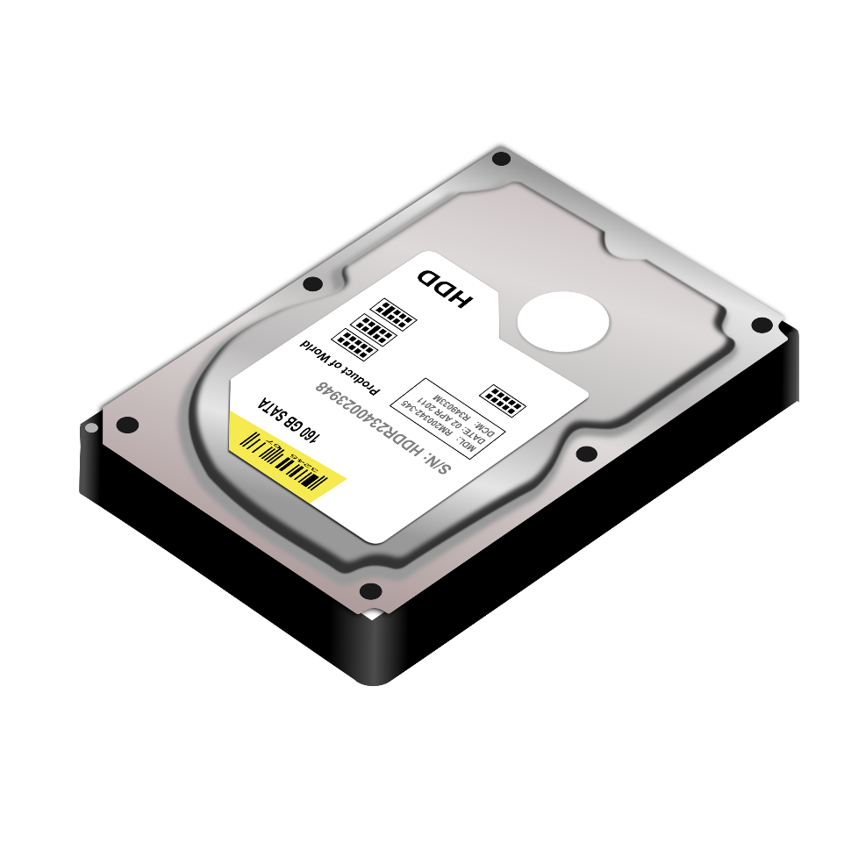

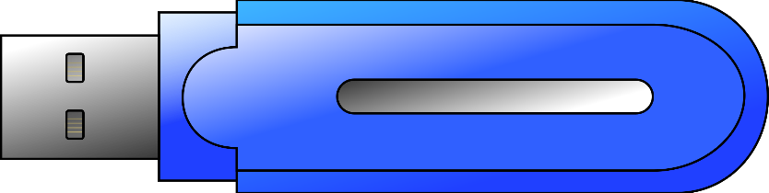
Hard Disks
Optical Drives
Solid State Drives

Slide 69
Hard Disks

Slide 70
Data Storage in Hard Disks
Magnetic storage (sequence of tiny magnets)
NRZI Encoding
with dummy bits
N
S
N
S
S
N
S
N
N
S
0
1
0
1

Slide 71
Structure of a Platter
Sector
Track
A platter is divided into concentric rings (track)
Each track is divided into fixed size sectors

Slide 72
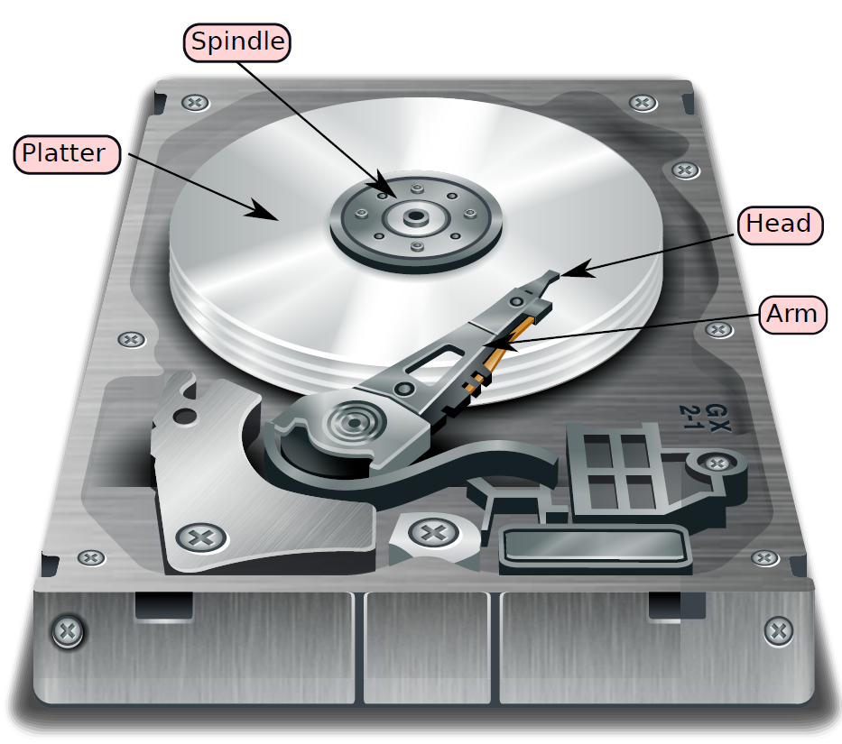
Structure of a Hard Disk

Slide 73
Structure in Detail
Spindle
Read/Write
head
Platter
Arm
Bus
Bus
Actuator
interface
Spindle motor
Drive
electronics

Slide 74
Accessing a Given Sector
Position the head on the correct track
seek time
Wait for the desired sector to come under the head
Rotational Latency
Assume that the hard disk rotates at constant angular velocity
Read or Write data
Perform error checking, correction, framing
Transfer data to the CPU → (Transfer Time)
The transfer starts when the head is on the first bit of the sector
$$T_{disk access}= T_{seek}+ T_{rot. latency}+ T_{transfer}$$

Slide 75
Logical vs Physical Block Address
Software programs use the logical block address to address a hard disk block (sector)
The hard disk internally converts the logical address to a physical address (recording surface, track, sector)
It dedicates a recording surface for storing this information.
It has a small cache (DRAM) to store the most recently used mappings
The hard disk can also use this mechanism to mark bad sectors and remap logical sectors to healthy physical sectors.

Slide 76
RAID – (Redundant Array of Disks)
Hard Disks tend to have high failure rates
Too many mechanical components
High temperature sensitivity
What do we do?
Do we lose all our data ....
NO
Use RAID
Redundant disks
To tolerate faults, and recover from failures

Slide 77
RAID – II
What about bandwidth?
Assume we want to read two different blocks from the same disk?
We need to read them serially.
Low Bandwidth
How can we increase bandwidth
Read from multiple disks in parallel.
Solution: RAID

Slide 78
RAID 0
Block 1
(512 bytes)
B1
B2
B3
B4
Distributing data across disks defined as data striping
B5
B6
B7
B8
B9
B10
Disk 1
Disk 2
No Reliability
Allows us to read even and odd blocks in parallel

Slide 79
RAID 1
B1
B1
B2
B2
B3
B3
B4
B4
B5
B5
Disk 1
Disk 2
Immune to one disk failure
Can read blocks B1 and B2 in parallel
100% overhead in storage

Slide 80
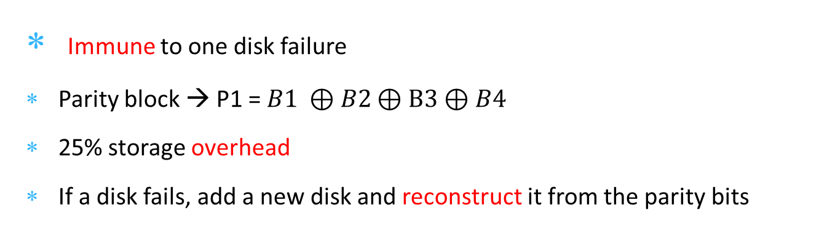
RAID 2, 3, 4
B1
B2
B3
B4
P1
B5
B6
B7
B8
P2
B9
B10
B11
B12
P3
B13
B14
B15
B16
P4
B17
B18
B19
B20
P5
Disk 1
Disk 2
Disk 3
Disk 4
Parity Disk
Immune to one disk failure
Parity block → P1 = $B1 ⊕B2⊕B3⊕B4$
25% storage overhead
If a disk fails, add a new disk and reconstruct it from the parity bits

Slide 81
RAID 2, 3, 4
Single point of contention
B1
B2
B3
B4
P1
B5
B6
B7
B8
P2
B9
B10
B11
B12
P3
B13
B14
B15
B16
P4
B17
B18
B19
B20
P5
Disk 1
Disk 2
Disk 3
Disk 4
Parity Disk
RAID | Block Size
2 | 1 bit
3 | 1 byte
4 | 1 block (512 bytes)
For reading a single block → access all the disks

Slide 82
RAID 5
B1
B2
B3
B4
P1
P2
B5
B6
B7
B8
B9
P3
B10
B11
B12
B13
B14
P4
B15
B16
B17
B18
B19
P5
B20
Disk 1
Disk 2
Disk 3
Disk 4
Disk 5
To avoid this problem: Distribute the parity blocks across the disks
Reliable + high bandwidth

Slide 83
RAID 6
B1
B2
B3
B4
P1A
P1B
P2B
B5
B6
B7
B8
P2A
P3A
P3B
B9
B10
B11
B12
B13
P4A
P4B
B14
B15
B16
B17
B18
P5A
P5B
B19
B20
Disk 1
Disk 2
Disk 3
Disk 4
Disk 5
Disk 6
Immune to two disk failures
Have two parity blocks (parity is computed differently)
High reliability at the cost of increased storage overhead

Slide 84
Optical Drives
CD
DVD
Blu-Ray

Slide 85
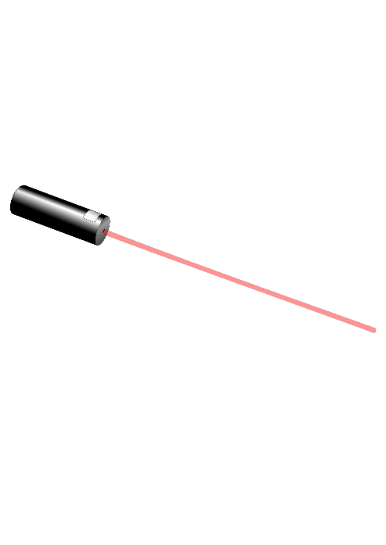
Structure of an Optical Disc
Plastic/ Surface Layer
Lacquer Layer
Reflective Layer
Pit
Land
Polycarbonate layer
Laser

Slide 86
Encoding Data
Physical bits:
Lands represent the physical bit 1
Pits represent the physical bit 0
Logical bits
Encoded using the NRZI encryption scheme
Elaborate error protection codes

Slide 87
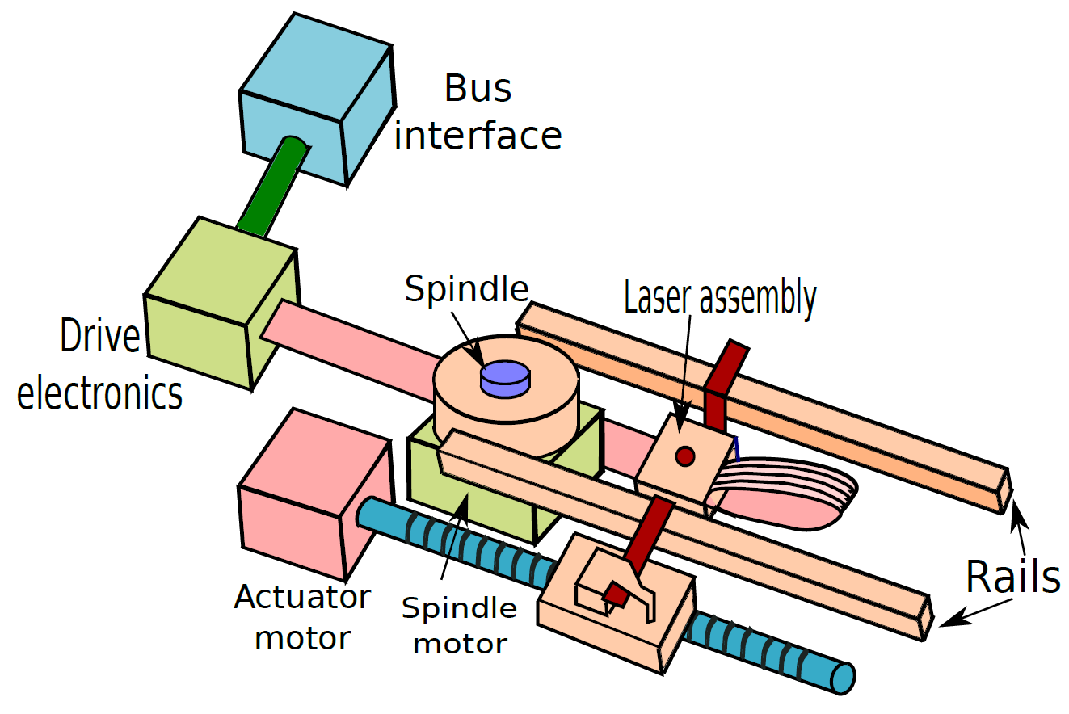
Design of an Optical Drive

Slide 88
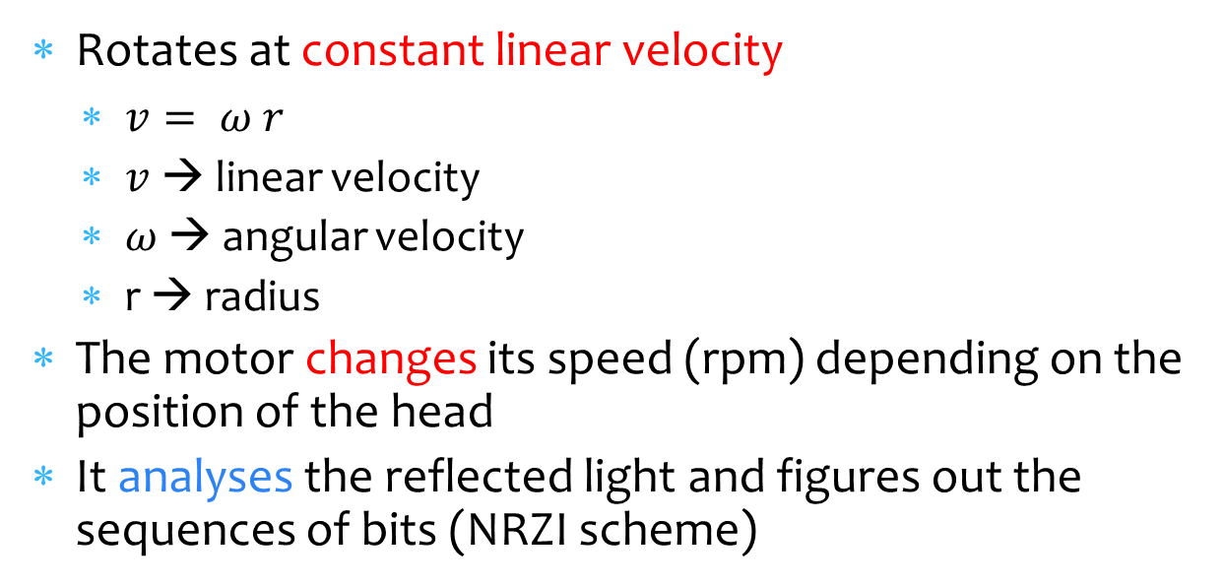
Operation of the Optical Disc Drive
Rotates at constant linear velocity
$v= ω r$
$v$→ linear velocity
$ω$ → angular velocity
r → radius
The motor changes its speed (rpm) depending on the position of the head
It analyses the reflected light and figures out the sequences of bits (NRZI scheme)

Slide 89
Technology Generations
 | CD | DVD | Blu-Ray
Generation | 1st | 2nd | 3rd
Capacity | 700 MB | 4.7 GB | 25 GB
Uses | Audio | Video | High Def. Video
Laser wavelength | 780 nm | 650 nm | 405 nm
Raw 1X transfer rate | 153 KB/s | 1.39 MB/s | 4.5 MB/s

Slide 90
Solid State Drives

Slide 91
Floating Gate (FG) Transistor
Control gate
SiO
Floating gate
2
Source
Drain
Symbol
(a)
(b)
The FG transistor has 2 gates – control gate and floating gate
When we apply a very high voltage to the control gate
Electrons get deposited in the floating gate
Increases the threshold voltage of the transistor
The FG transistor is said to be programmed (value = 0)
Not programmed (value = 1)

Slide 92
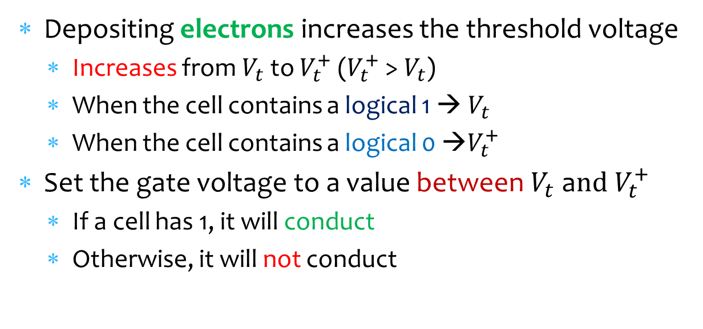
Reading the Value in a FG Transistor
Depositing electrons increases the threshold voltage
Increases from $V_{t}$ to $V_{t}^{+}$ ($V_{t}^{+}$ > $V_{t}$)
When the cell contains a logical 1 → $V_{t}$
When the cell contains a logical 0 →$V_{t}^{+}$
Set the gate voltage to a value between $V_{t}$ a$nd V_{t}^{+}$
If a cell has 1, it will conduct
Otherwise, it will not conduct

Slide 93
NOR Flash
Bit
line
WL1
WL2
Rarely used → low density, low bandwidth, faster
Read the value of the bit line using a sense amplifier
Operation → Similar to a DRAM array (see Chapter 6)

Slide 94
NAND Flash
Bit line
Ground
WL6
WL5
WL3
WL2
WL1
Bit line
select
WL8
WL7
WL4
select
To read a certain transistor, enable the rest of the transistors and ground select and bit line select
High density
40-60% more density than NOR flash

Slide 95
Blocks and Pages
A page contains 512-4096 bytes of data
Most NAND flash devices read/write data at the granularity of pages
Has additional bits for error correction (CRC)
Blocks contain 32-128 pages
Size: 16 to 512 KB
Can erase data at the level of blocks (deprogram)
Program Erase Cycle
To rewrite a page, we need to erase it first
Converting 0s to 1s (deprogramming) is slow and has to be done at large granularities

Slide 96

Wear Levelling
Flash memory can only tolerate a certain number (100k) of program/erase cycles (P/E)
The SiO₂ layer breaks down and does not remain an insulator, hence the device cannot hold charge anymore
Solution :
Keep counters for each block
Increment the counter on each P/E cycle
Aim: Ensure that the number of P/E cycles for each block is roughly the same.

Slide 97
Wear Levelling and Read Disturbance
Wear Levelling
Once a counter reaches a high value.
Swap the contents of a frequently accessed block with a less frequently accessed block
Keep a high level mapping table:
Logical block number → Physical block location
Just change the mapping in this table
Read disturbance
It is possible that repeatedly reading a transistor causes the contents of the rest of the transistors to change
Same approach: have a counter, copy the block to another location, if the counter exceeds a threshold.

Slide 98
THE END

